Slide 1

Qualitative behaviour of ecological models
Vincent Jansen
vincent.jansen@rhul.ac.uk

Slide 2
Introduction
Population dynamics describe change over time
Aim of population and community ecology is to understand the processes underlying patterns of change
I hope this course will help in understanding the qualitative behaviour of mathematical models

Slide 3
Introduction
Most models that are of interest in biology are non-linear dynamical systems
Mathematical analysis tools are sharpest for linear systems
Analysis is often only possible to a limited extent, but at the same time, provides a powerful tool to understand the dynamics

Slide 4
Introduction
I will use dynamical systems theory and bifurcation theory and apply this to ecological models
The ecological models mainly describe the interactions between one and two species
I will try to provide a mix of biological background and justification and mathematical analysis, building on what you have done before in this course

Slide 5
Overview
Single species models, stability, the metapopulation concept
Interspecific competition, phase plane, eigenvalues & eigenvectors
Alternative stable states, phase shifts and catastrophic transitions
Chaos and unpredictability
Predator-prey models, limit cycles, Hopf bifurcation
Epidemiological models

Slide 6
Single species models, stability, metapopulations
Vincent Jansen
vincent.jansen@rhul.ac.uk

Slide 7
Outline
Exponential Growth
Logistic growth
Stability
Metapopulations
Pair approximations

Slide 8
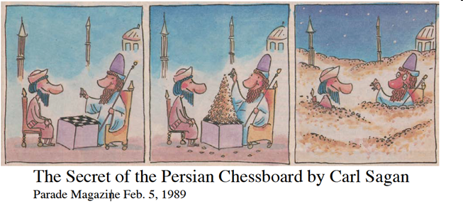
Exponential Growth
The courtier and the Persian king
The simplest model for growth is to assume that the net per capita growth is density independent
It goes back many centuries
Notes:
According to legend, a courtier presented the Persian king with a beautiful, hand-made chessboard. The king asked what he would like in return for his gift and the courtier surprised the king by asking for one grain of rice on the first square, two grains on the second, four grains on the third etc. The king readily agreed and asked for the rice to be brought. All went well at first, but the requirement for 2 n − 1 grains on the nth square demanded over a million grains on the 21st square, more than a million million (aka trillion) on the 41st and there simply was not enough rice in the whole world for the final squares.

Slide 9
Exponential Growth
Sequence 1,2,4,8,16,32,64,128,256,512, etc.
Or 2⁰, 2¹, 2², 2³, 2⁴ etc
He would get 18446744073709551615 grains of rice, that is about 5 x 10¹¹ metric tons, more than 500 times the current yearly global rice production!

Slide 10
grains
squares

Slide 11
Log₂[grains]
squares

Slide 12
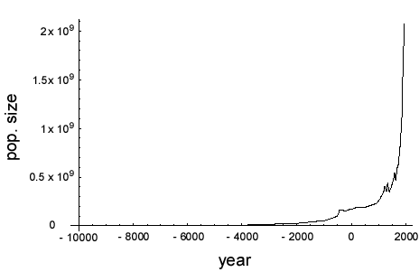
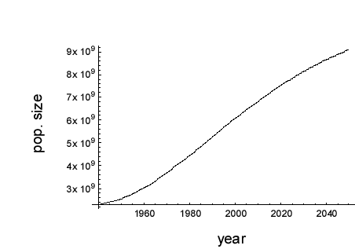
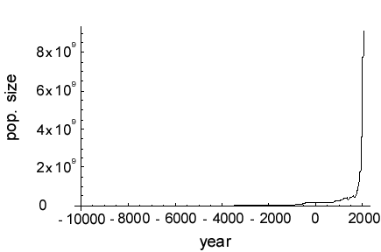
Humans vs Bacteria: the growth of the human population

Slide 13
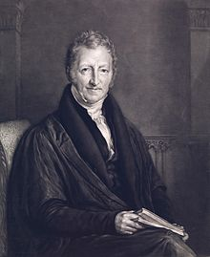
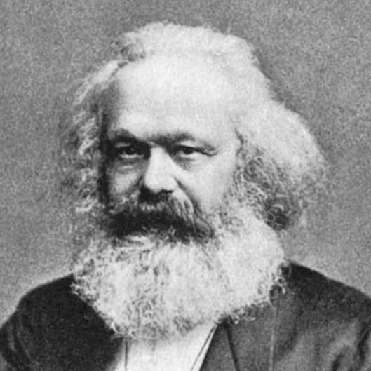
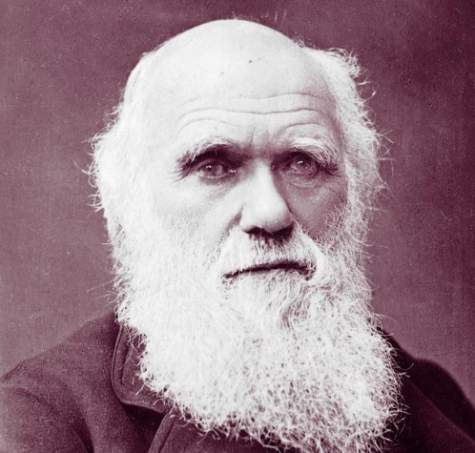
Humans vs Bacteria:
The end is nigh!
Can we find any patterns in human population growth?
Malthus wrote an essay (1789) in which he claims that the human population grows geometrically
The view that the human population grows in a similar fashion to a bacterial population has been very influential
The reverend Thomas Malthus
Revolution!
Marx
Evolution!
Darwin
Notes:
This claim still resonates today, see e.g. Albert Bartlett’s view on human population growth

Slide 14
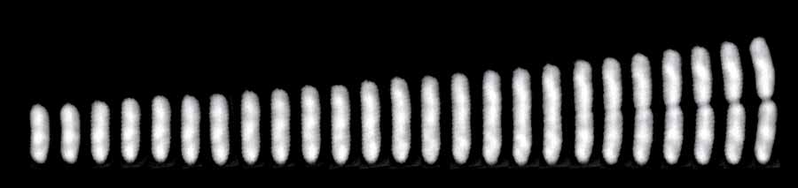
Humans vs Bacteria: Bacterial growth
A single E. coli cell dividing
Bacteria multiply by dividing in 2
So you get 1,2,4,8,16,32 etc bacteria
This is a geometric series (all terms powers of 2)
Notes:
http://ucsdnews.ucsd.edu/pressrelease/study_sheds_light_on_what_causes_cells_to_divide

Slide 15
Bacterial Growth
Absorbancy
Escherichia coli grown on minimal salts and complex medium
Time (mins)
Absorbancy
Time (mins)
http://biology.clc.uc.edu/fankhauser/labs/microbiology/growth_curve/growth_curve.htm

Slide 16
Humans vs Bacteria
Humans
Bacteria
Absorbancy
Time (mins)
Time (mins)

Slide 17
Do human and bacterial populations grow in the same way?
Obviously the time scale is different
But are the growth curves the same or different?
To find out we will build a simple model for exponential (geometric) growth, and see if Malthus was right.
Exponential!
The reverend Thomas Malthus

Slide 18
Exponential Population Growth
If we assume births and death rates are proportional to the size of the population:
Births = b N_{t}
Deaths = d N_{t}
This amounts to assuming that the probability of a person giving birth (or dying) is independent of population size.
b: per capita birth rate
d: per capita death rate

Slide 19
Exponential Growth (discrete time)
With a constant per capita birth and death rate we find a growth process similar to the accumulation of interest:
N_{t+1}-N_{t} =bN_{t}-dN_{t}=rN_{t} (r=b-d, is the net per
capita growth rate)
or
N_{t+1}=(1+b-d) N_{t}=(1+r)N_{t}
General solution:
N_{t}=N₀(1+r)^{t}

Slide 20
Exponential growth (discrete time)
A simple prediction:
If growth is exponential then the logarithm of the population size increases linearly
where a=ln(N₀) and b=ln(1+r) .

Slide 21
Exponential Growth

Slide 22
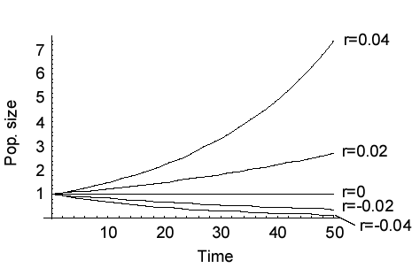
Exponential growth
The net growth rate r=b-d

Slide 23
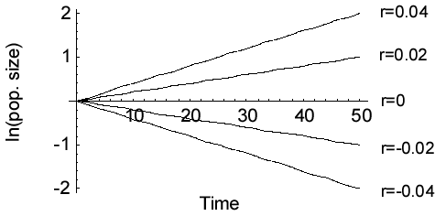
Exponential growth

Slide 24
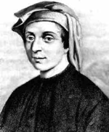
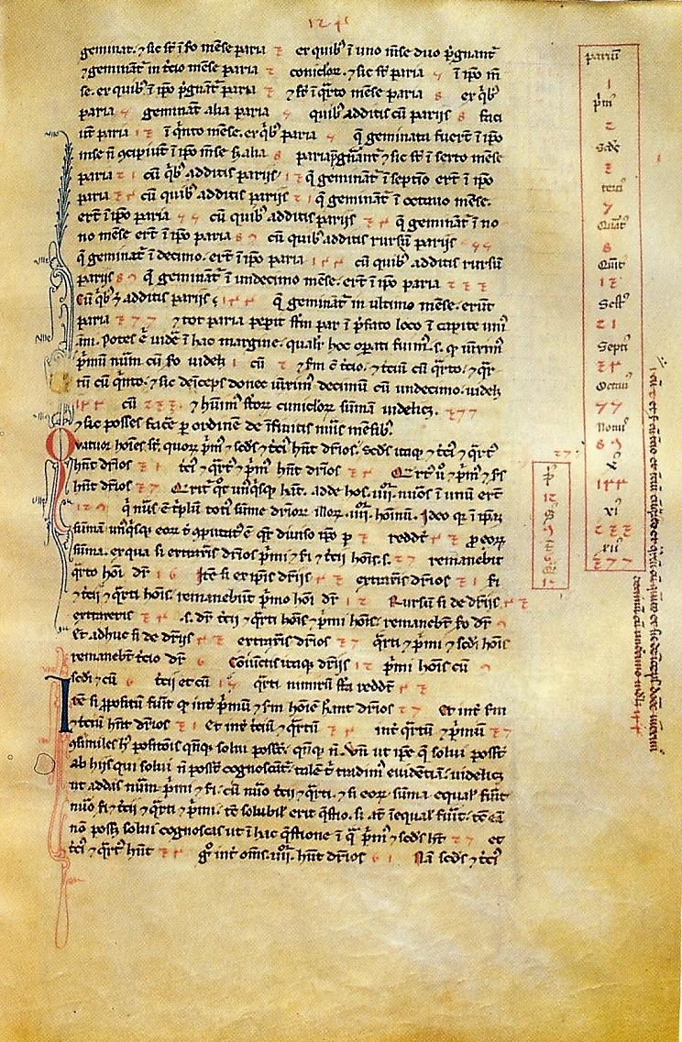
The Fibonacci sequence
Leonardo of Pisa (Fibonacci)
(c. 1170 – c. 1250)
Page from the Liber Abaci, with the Fibonacci sequence
Suppose a newly-born pair of rabbits, one male, one female, are put in a field. Rabbits are able to mate at the age of one month so that at the end of its second month a female can produce another pair of rabbits. Suppose that our rabbits never die and that the female always produces one new pair (one male, one female) every month from the second month on. How many pairs will there be in one year ?

Slide 25
The Fibonacci sequence
Leonardo of Pisa (Fibonacci)
(c. 1170 – c. 1250)
Suppose a newly-born pair of rabbits, one male, one female, are put in a field. Rabbits are able to mate at the age of one month so that at the end of its second month a female can produce another pair of rabbits. Suppose that our rabbits never die and that the female always produces one new pair (one male, one female) every month from the second month on. How many pairs will there be in one year ?

Slide 26
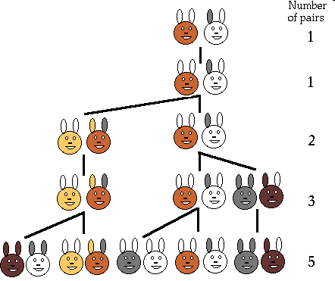
1,1,2,3,5,8,13,21,34,55,89,144

Slide 27
Fibonacci’s rabbits
ln[nr of rabbits]
time

Slide 28
Exponential growth (continuous time)
If we assume constant per capita birth and death rates:
Which can be rewritten as
where r=b-d is the per capita growth rate .
This is the exponential growth model for overlapping generations
b N – d N = (b - d) N
r N

Slide 29
Exponential growth in continuous time
r N
Previous examples were in discrete time
The differential equation
Can be solved to give:
Where N(0) is the population size at time t=0 and e is a constant (the base of the natural logarithm) with value ≈2.718

Slide 30
Exponential growth
The net growth rate r=b-d

Slide 31
Exponential growth

Slide 32
Humans vs Bacteria analysed
So let’s see, do humans or bacterial populations show exponential (=geometric growth)?

Slide 33
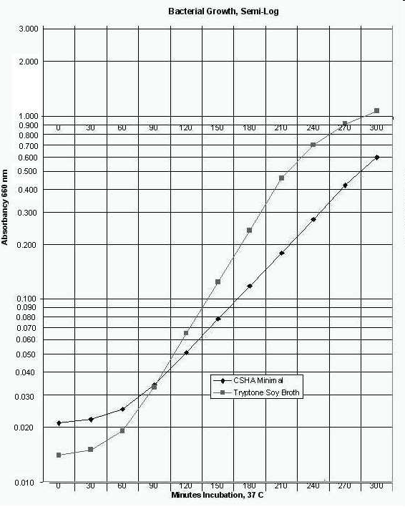
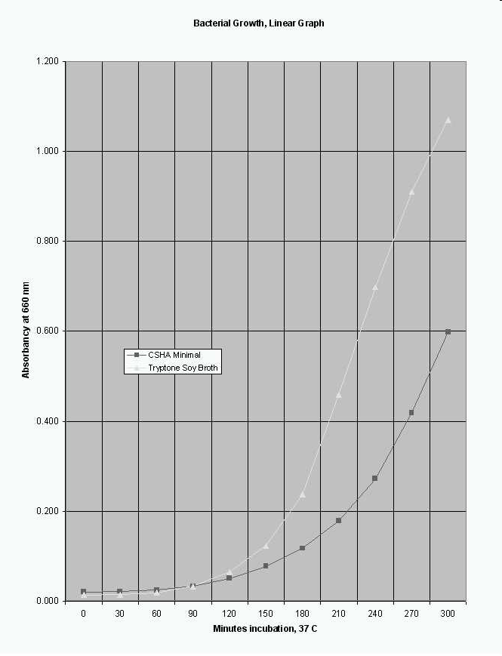
Example: Bacterial Growth
Escherichia coli grown on minimal salts vs complex media
http://biology.clc.uc.edu/fankhauser/labs/microbiology/growth_curve/growth_curve.htm

Slide 34

Example: Human Population Growth

Slide 35
Human Population Growth

Slide 36
Growth Rate
We can use the exponential model to calculate per capita growth rates
If we measure the population at times 0 and T the model predicts:
Solving for r we find

Slide 37
Are growth rates constant for bacteria?
Simple medium
Complex medium
Growth rate
Time (mins)
Time (mins)

Slide 38
Are human population growth rates constant?

Slide 39
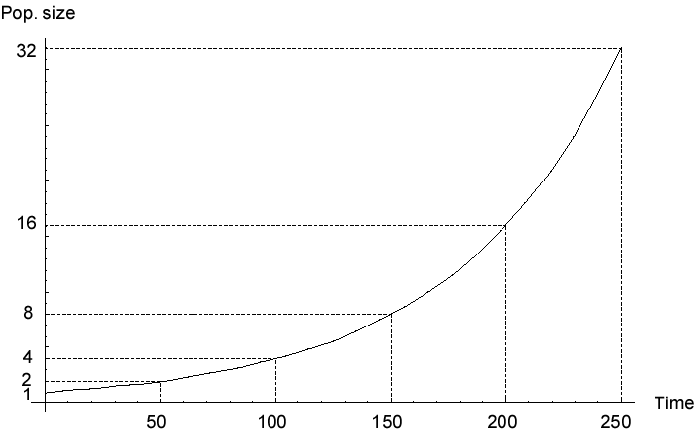
Doubling Time
In the exponential growth model the population sizes double in a given amount of time.
This is called the doubling time

Slide 40
Doubling Time
To calculate the doubling time we solve:
Solving for t_{double} we find:

Slide 41
Doubling Time
The doubling time of the bacterial population is about 50 mins.
For the human population it was, over the last 12000 years, approx. 900 years
From 1950 until now it was approx. 35 years

Slide 42
Density Dependence
For the exponential growth rate we assumed the per capita growth rate is independent of the population size
Let’s see if that is correct

Slide 43
Are growth rates constant for bacteria?
Simple medium
Complex medium
Growth rate
Absorbancy (density)
Absorbancy (density)

Slide 44
Density Dependence in the Human population

Slide 45
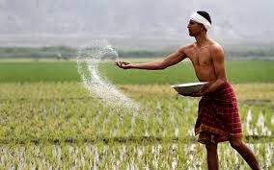

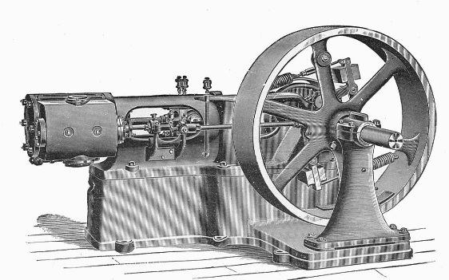

Density Dependence in the Human population
For big populations the growth rate declines with size
But initially the growth rate increased with sizes: the bigger the population got the better we did.
This is where Malthus was wrong: humans are not like bacteria, and we have not ran out of resources yet

Slide 46
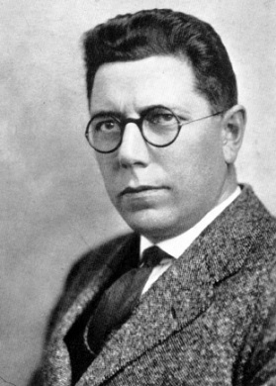
Growth curve of yeast
Raymond Pearl (1879-1940)
From R. Pearl (1927) Q. Rev. Biol. 2 532-548 using data from Carlson (1913) Biochem. Zeitschr. 57, 313-334
Notes:
Pearl: In 1926, his book, Alcohol and Longevity,^{[7]} demonstrated that drinking alcohol in moderation is associated with greater longevity than either abstaining or drinking heavily. In 1938, his data and work demonstrated the negative health effects of smoking tobacco.

Slide 47
Growth curve of yeast
Per capita growth rate
Population density

Slide 48
Logistic Growth
The per capita growth rate depends on the population size
To study the effects of a density dependent growth rate let’s assume the growth rate decreases linearly with the population size

Slide 49
Logistic Growth
The per capita growth rate depends on the population size
To study the effects of a density dependent growth rate let’s assume the growth rate decreases linearly with the population size
rk
-rk

Slide 50
Logistic Growth
per capita growth rate is a function of N, in this case we use r(k-N)
The population growth can be described as:
The parameter k is the carrying capacity
This is the logistic growth model
Note: slightly different parametrisation from other texts

Slide 51
Logistic Growth
Solutions converge to the carrying capacity, k, if r>0.
This is an equilibrium of the model

Slide 52
Calculation of the equilibria
To find the equilibria we solve
To give
or

Slide 53
Stability of the equilibria
We study the dynamics close to the equilibrium
In general, if the dynamics are given by
Equilibrium:

Slide 54
Stability of the equilibria
We can expand F in a Taylor series around
And because we are studying the dynamics close to the equilibrium point (where ) this simplifies to:
Using , we can now write the linearised dynamics as:

Slide 55
Stability of the equilibria
For the logistic model this gives us as the linearised dynamics close to equilibrium:

Slide 56
Stability of
The dynamics close to equilibrium are approximately:
With solution
The rate rk is called the eigenvalue
The equilibrium is stable if rk<0
and unstable if rk>0

Slide 57
Stability of
Eigenvalue

Slide 58
Stability of
The dynamics close to equilibrium are approximately:
The equilibrium is unstable if rk<0
and stable if rk>0

Slide 59
Stability of
Eigenvalue

Slide 60
Bifurcation diagram
A transcritical bifurcation

Slide 61
Now do Practical 1: Make bifurcation diagram for the continuous logistic equation.

Slide 62
Logistic growth
But what does the logistic growth model really mean?
The carrying capacity is often interpreted as a parameter of the system with a biological meaning
Often the carrying capacity depends on life history parameters (pair approximations)

Slide 63
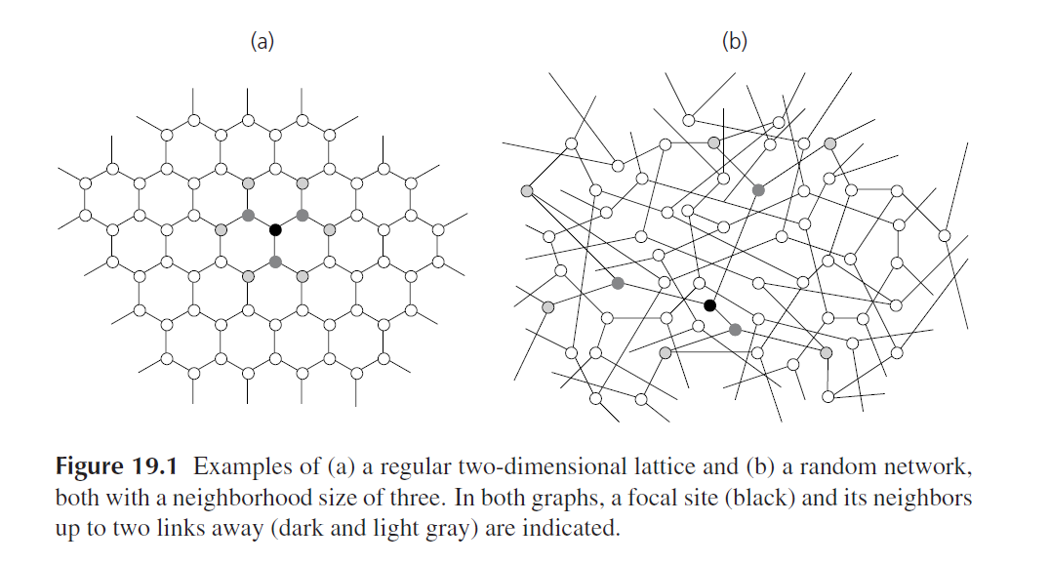
Pair approximations
From: van Baalen, M. (2000). Pair approximations for different spatial geometries. Pages 359-387 in: U. Dieckmann, R. Law, & J.A.J. Metz, Eds. The Geometry of Ecological Interactions: Simplifying Spatial Complexity. Cambridge University Press, Cambridge.

Slide 64
Pair approximations
More refined spatial model: count the pairs of sites occupied on a lattice.
If the birth and death rates depend on global densities the logistic equation is recovered
If the rates depend on the local densities, you need a much more complicated model (see e.g. van Baalen 2000) as you need to take local correlations into account.
The carrying capacity now becomes a compound parameter which depends on the birth and death rates.

Slide 65
Another example: the metapopulation
The idea of a population of populations goes back to Andrewartha and Birch (1954) and Nicholson and Bailey (1934)
Richard Levins coined the term in 1969
The idea is related to McArthur and Wilson’s island biogeography

Slide 66
The Metapopulation Concept
Metapopulation:
A population of populations
Small populations are prone to become extinct
This can be due to external factors
Or through chance fluctuations (demographic stochasticity)
Regional persistence despite local extinction

Slide 67
Metapopulation Theory
Major assumption of metapopulation theory:
Local population dynamics are fast compared to the lifetime of a local population
The local densities reach equilibrium quickly after colonisation
All patches are the same

Slide 69
Metapopulation Theory
The number of occupied patches, rather than the number of individuals is the variable of interest
it is sufficient to know how many patches are occupied
p = fraction of patches occupied

Slide 70
Metapopulation Theory
Every patch has a similar rate of sending out dispersers (m p), which need to find empty patches (1-p). Colonisation rate m p (1-p)
Extinction rate, e, nr of extinctions: ep
Levins’ metapopulation model

Slide 71
Metapopulation Theory
Solution to the Levins’ model

Slide 72
Metapopulation Theory
This is of course just the same as the logistic growth model
with

Slide 73
Metapopulation Theory
At equilibrium p=1-e/m

Slide 74
Metapopulation Theory
Two observations:
For the metapopulation to persist colonisation needs to exceed extinction
There will always be unoccupied patches
The carrying capacity depends on the colonisation and extinction rates

Slide 75
Habitat destruction
Habitat destruction can easily be incorporated in metapopulation theory by assuming a fraction D cannot be colonised

Slide 76
Habitat destruction
Equilibrium fraction (1-D-e/m) decreases with habitat destruction:
D=
0
0.1
0.2
0.3
0.4
0.5

Slide 77
Metapopulations
Note that in this respect the metapopulation model behaves fundamentally different from other models
Normally, reducing the area, say halfing it, halves the population size
In a metapopulation taking 60% of the area will have the effect of subtracting 60% from the equilibrium population size, and this could actually cause extinction

Slide 78
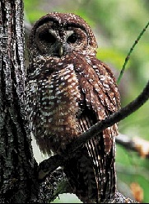
The Spotted Owl Debate
the metapopulation was used in the debate around the protection of the northern spotted owl (Strix occidentalis caurina) in the USA

Slide 79
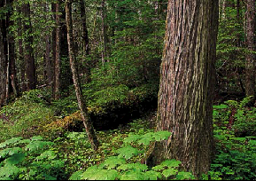
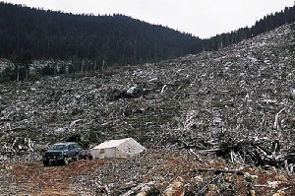
The Spotted Owl Debate
The northern spotted brown owl lives in old woodland in the north western USA (California, Oregon) and Canada
Increased logging of old forest is threatening the northern spotted owl

Slide 80
The Spotted Owl Debate
Logging is important for the local economy
By 1950 only 10-15% of the original old forest was left and the remaining forests were publicly owned
Logging continued leading to habitat loss and habitat fragmentation

Slide 81
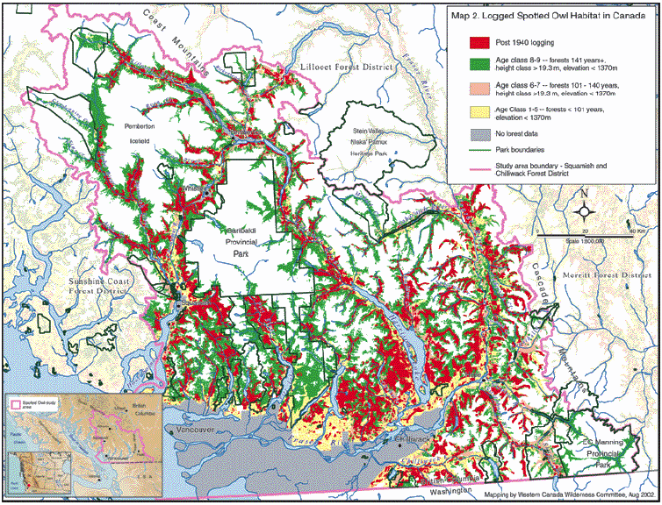
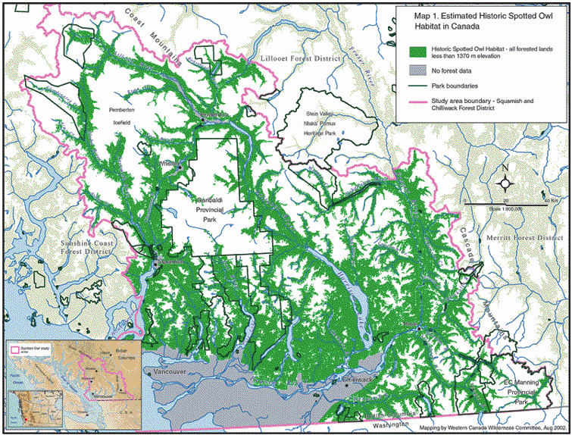

Slide 82
The Spotted Owl Debate
The northern spotted owl was listed as threatened in Oregon under the “Endangered Species Act”
This legally obliged the state to provide protection for this species, and its habitat
It caused a conflict environmental groups and timber industry

Slide 83
The Spotted Owl Debate
The spotted owl is an indicator species: a decline indicates that other species are possibly declining too
To breed and reproduce it needs large territories (400-3200 ha) of old forest (>150 yrs)

Slide 84
The Spotted Owl Debate
Young owls disperse and need to find new territories
Not all territories are occupied at all times
Territories fall empty and are reoccupied

Slide 85
The Spotted Owl Debate
This was an important element of the debate:
In order to protect the Spotted Owl, the Endangered Species Act states that the habitat has to be protected
Metapopulation models were used in court to make this case
Cutting down unoccupied territories can endanger the species, even if it doesn’t endanger individuals

Slide 86
Plan withdrawn by Obama administration in July 2009
Nature, 10 Oct, 2007

Slide 87
Examples of Metapopulations
Examples of metapopulations:
A number of butterfly populations have a metapopulation structure (Plebejus argus, Glanville fritillary, bay checkerspot)
Daphnia in rock pools
Voles on islands
(see Hanski’s books)

Slide 88
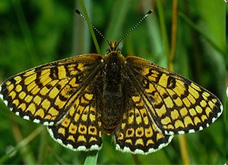
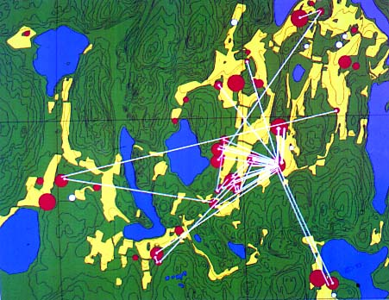
Examples of Metapopulations
Glanville fritillary (Melitaea cinxia)
Notes:
studied in the summer of 1991 on the Åland islands. A total of 1737 butterflies were marked, of which 741 were recaptured later. Most butterflies were recaptured on the same meadow, but 46 individuals migrated to a nearby patch.

Slide 89
Metapopulations and carrying capacity
What the metapopulation demonstrates is that the carrying capacity is not a simple parameter of the system
It depends on other factors, such as birth and death rates, or the ability to colonise space.
This has been generalised in other spatial models

Slide 90
Rescue effect
The Levins’ metapopulation assumes extinction rates are constant
colonisation
extinction

Slide 91
Rescue effect
Population numbers in a patch could depend on the number of patches occupied in the vicinity (immigration)
The extinction rate will decrease if more patches are occupied.
Hanski proposed e=e₀ exp(-ap)

Slide 92
Rescue effect
The rescue effect can create alternative stable states, with the effect that the metapopulation becomes extinct if reduced below a threshold fraction

Slide 93
Rescue effect
The Levins’ metapopulation assumes extinction rates are constant
Population numbers in a patch depend on the number of patches occupied in the vicinity (immigration)
The extinction rate will decrease if more patches are occupied.
Hanski proposed e=e₀ exp(-ap)

Slide 94
Rescue effect
If e=e₀ exp(-ap)
extinction
colonisation

Slide 95
Rescue effect
The rescue effect can create alternative stable states, with the effect that the metapopulation becomes extinct if reduced below a threshold fraction

Slide 96
Do Practical 1, questions on metapopulation theory after the lectures.

Slide 97
Learning outcomes
Understand the exponential and logistic growth model
Appreciate how to understand the qualitative outcomes of the model and how they depend on the parameters.
Understand how the logistic model links to more detailed biological, e.g. metapopulation models

Slide 98
Rescue effect
Equilibria:
The last eqn is transcedental: we cannot solve it in closed form for p

Slide 99
Rescue effect
We can employ a trick here. Even though we cannot solve it for p*, we can solve it for m as

Slide 100
Rescue effect
m
p*
p*
m

Slide 101
Rescue effect
Linearised model:

Slide 102
Rescue effect
Now note that:
And hence:

Slide 103
Rescue effect
m
p*
Stable if
p*
m

Slide 104
Fibonacci’s rabbits
Difference equation
{{-1,1},{1,0}} (juvenile, adults)
Recurrence
{{0,1},{1,1}}
- λ(1- λ)+1=0
λ=1/2+-1/2 sqrt 5

Slide 105
*Fibonacci’s rabbits, dying
Difference equation
{{-1,1,1},{1,-1,0},{0,1,-1}}
Recurrence
{{0,1,1},{1,0,0},{0,1,0}}
1+ λ- λ^3 =0
No simple solution, but has one ev at approx 1.324<1/2+1/2 sqrt 5
Problem can be rewritten to Padova sequence:
x(t)=x(t-2)+x(t-3)
See
http://matheminutes.blogspot.co.uk/2012/02/killing-fibonaccis-rabbits.html

